Slide 1
Quarterly Research Update
Q3 2026 · Analytics team
Notes:
Welcome everyone; this deck summarises the third quarter.

Slide 2
Key findings
Customer churn fell to 4.2 per cent after the onboarding redesign.
Support tickets per customer dropped by a third.
Net revenue retention reached 112 per cent.
Notes:
Stress that churn is the headline: it was 6.8 per cent a year ago.

Slide 3
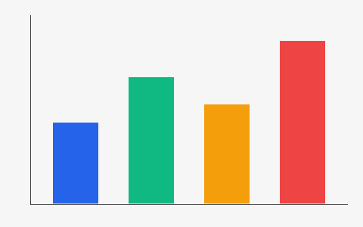
Regional growth
The western region grew fastest, at 18 per cent year on year.
Notes:
Point at the red bar: that is the west.

Slide 4
Pipeline by stage
Stage | Deals | Value (£k)
Qualified | 42 | 1,260
Proposal | 17 | 830
Negotiation | 6 | 410
Notes:
The negotiation stage is small but closes at 70 per cent.

Slide 5
Revenue by quarter
Next steps: expand the pilot to three more cities.
Notes:
Ask for budget approval before the December board meeting.

